Slide 1

Windows Mobile App Development
GID 00333535

Slide 2

IMAGE DUNIA

Slide 3

IMAGE DUNIA
This app contains 100's of Wallpaper, Quotes, Wishes, Smileys and lot more which are updated daily. These Can be used in Whatsapp, Facebook, twitter, gmail, weChat, hike, Line and lot more.

Slide 4
Features : -
Features : -
Set Images as Wallpaper
High Quality Wallpapers
Save Images to gallery
-Share Images and Smileys to social media such as Whatsapp, FB and lot more
- Latest collections Updated Daily

Slide 5
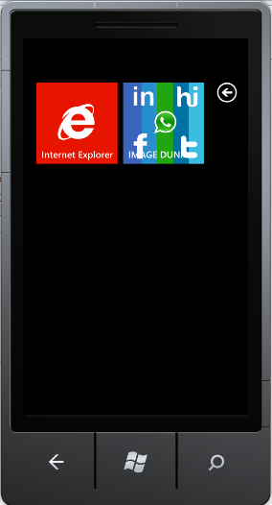
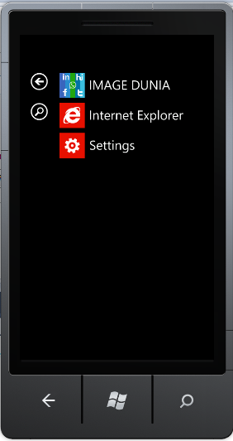
TILE AND APPLICATION LIST

Slide 6
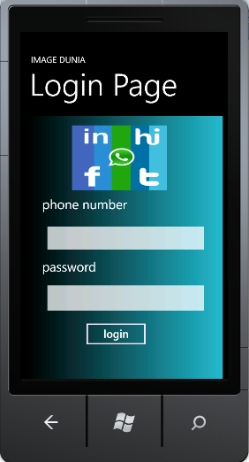
LOGIN PAGE

Slide 7
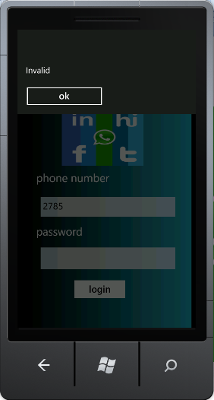
UNAUTHORISED USER

Slide 8
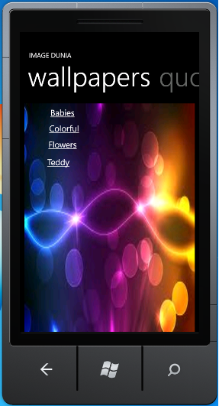
FOR AUTHORISED USERS WALL PAPERS

Slide 9
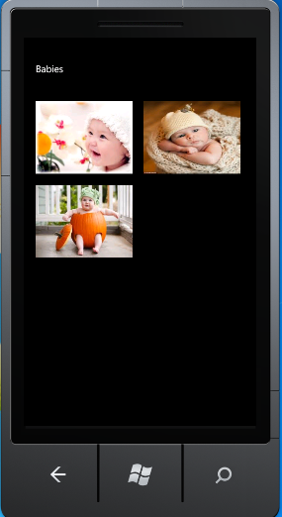
BABIES

Slide 10
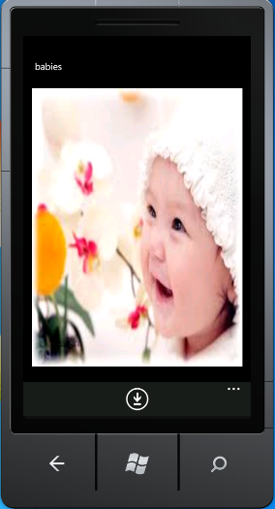
ENLARGED IMAGE

Slide 11
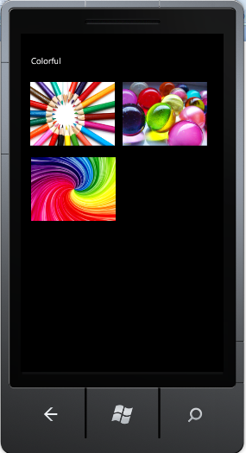
COLORFUL

Slide 12
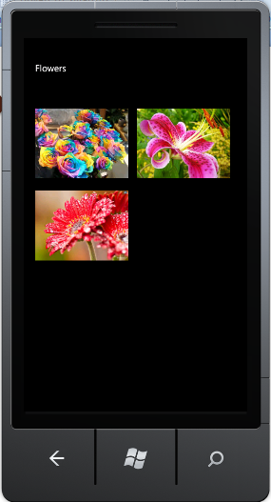
FLOWERS

Slide 13
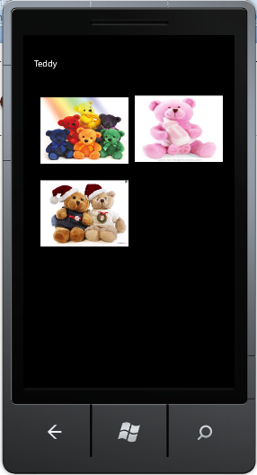
TEDDY

Slide 14
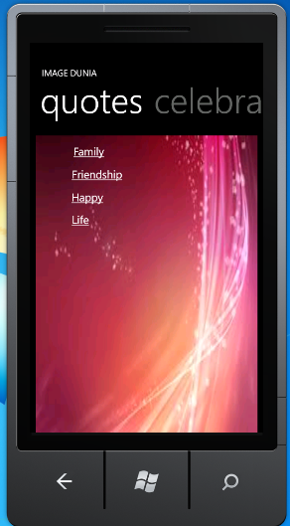
QUOTES

Slide 15

FAMILY QUOTES

Slide 16
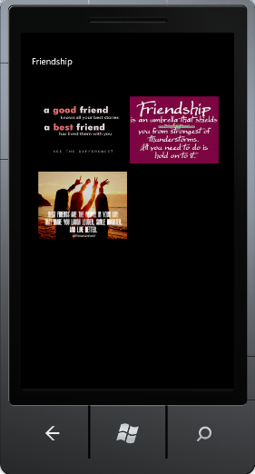
FRIENDSHIP QUOTES

Slide 17
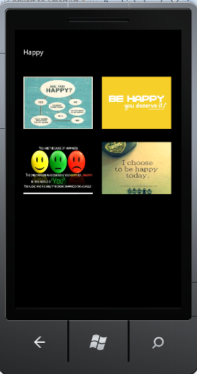
HAPPY QUOTES

Slide 18

LIFE QUOTES

Slide 19
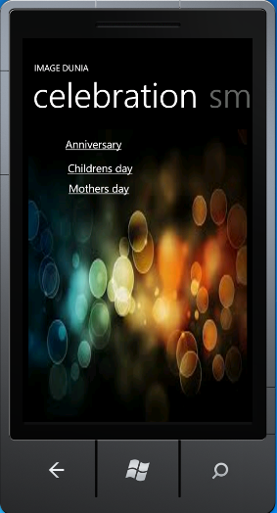
CELEBRATION

Slide 20
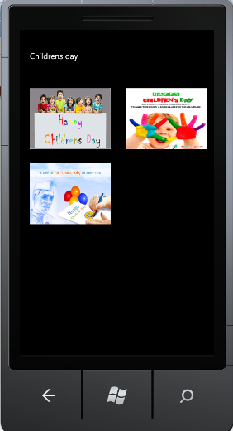
CHILDRENS DAY

Slide 21
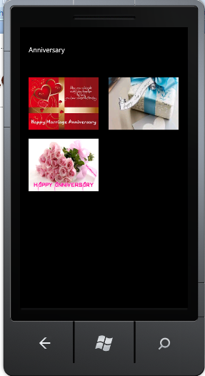
ANNIVERSARY

Slide 22
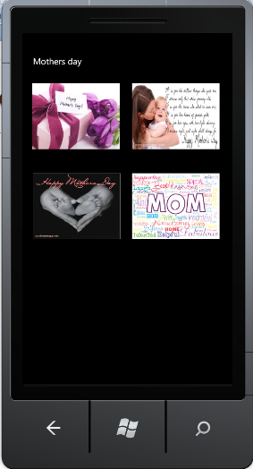
MOTHERS DAY

Slide 23
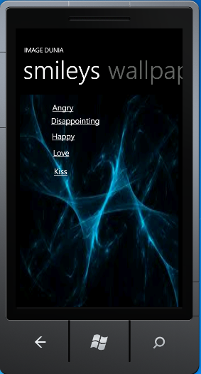
SMILEYS

Slide 24
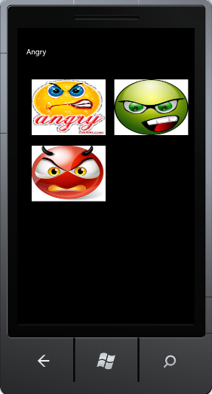
ANGRY

Slide 25
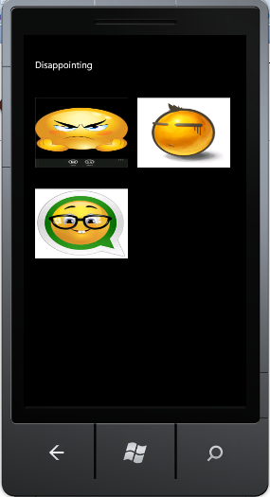
DISAPPOINTING

Slide 26
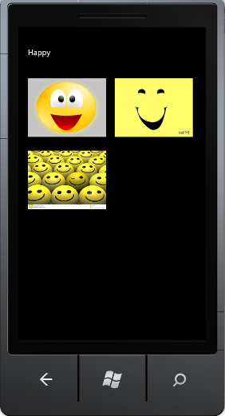
HAPPY

Slide 27
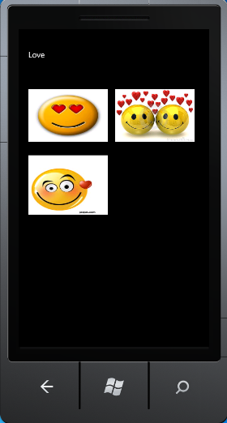
LOVE

Slide 28
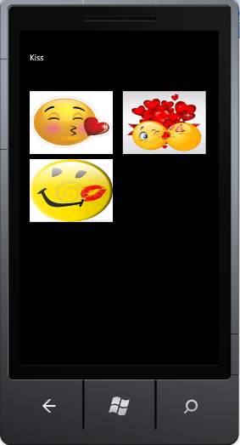
KISS

Slide 29


